Slide 1
Lab meeting
尹纯友
2020/12/30

Slide 2
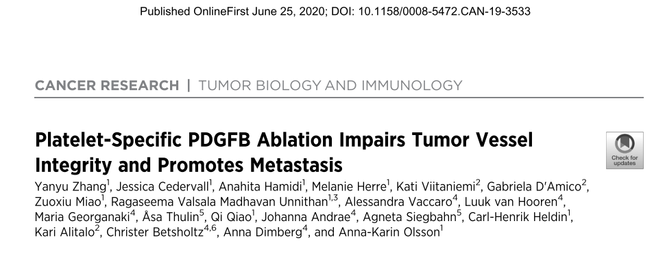

Slide 3
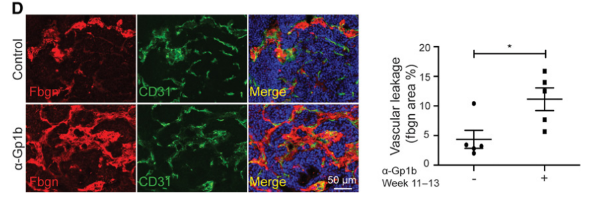
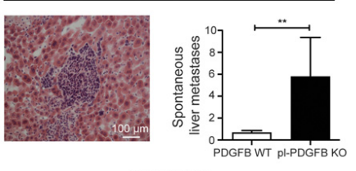
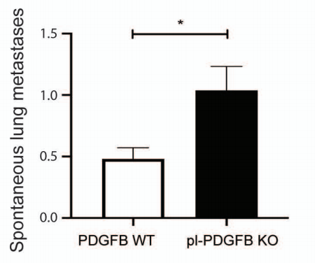
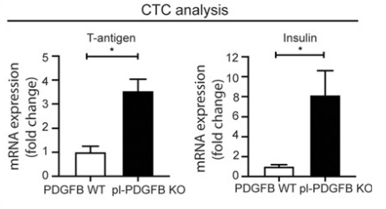
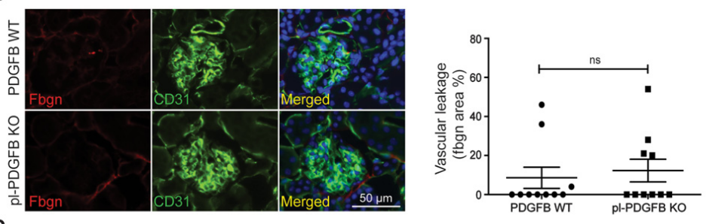
How to quantify the depletion effects?
Vascular leakage
Number of circulating tumor cells
Metastasis to liver or lung

Slide 4
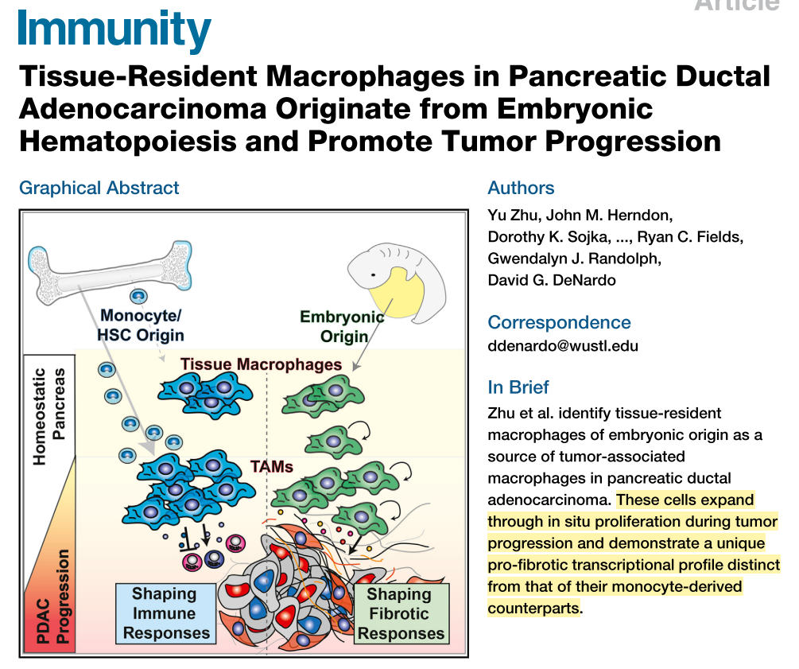
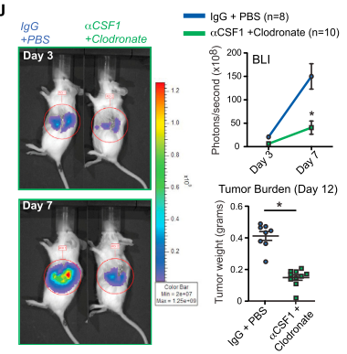
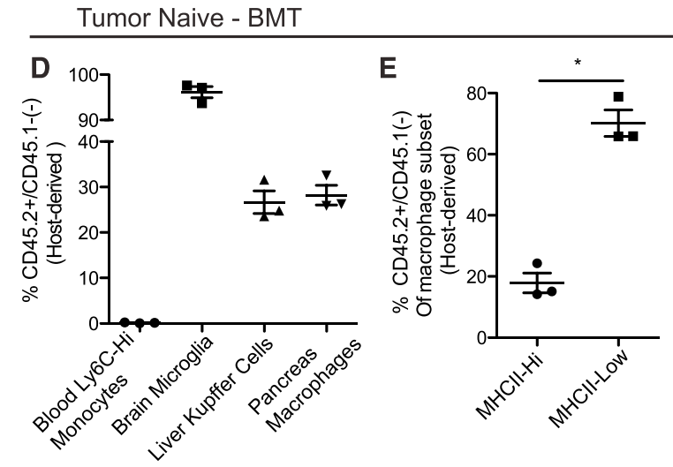
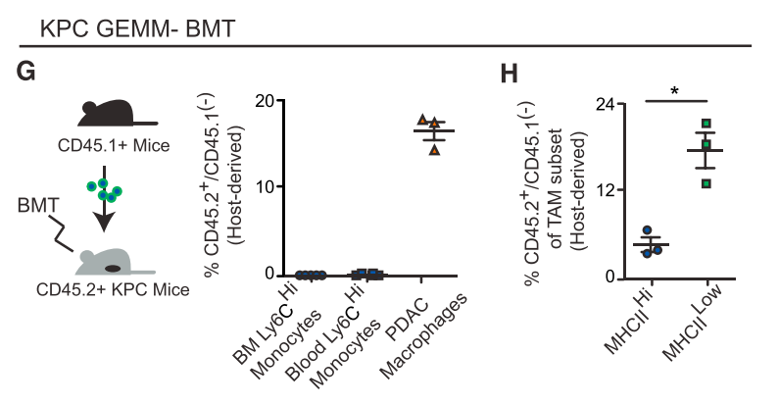

Slide 5
对侧肾 肾内肿瘤

Slide 6
plans
Pdgfb Knockout or Cx3cr1^{CreER} ｘiDTR depletion effects:
Tumor volume
Vascular density
Intra tumor CD8+ T cell
Vascular leakage
Circulating tumors
Metastatsis
Pdgfb mediates tumorgenic effects
纯化 SM-MФ，检测 Pdgfb 在静息和肿瘤内的表达变化

Slide 7
kidney macrophage after LPS challenge

Slide 8
Control 48h 72h

Slide 10
Urine total protein after LPS challenge

Slide 11
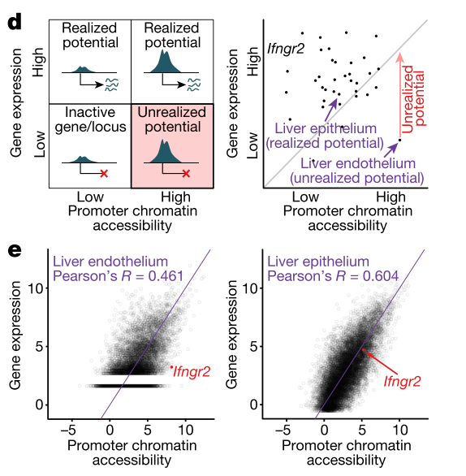
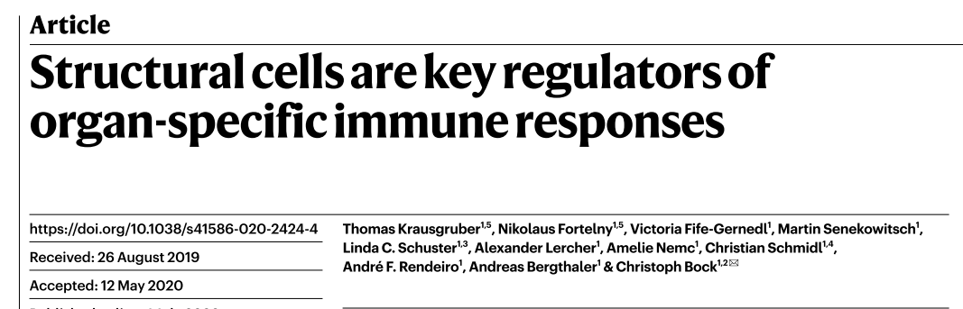

Slide 12
plans
where the macrophage comes from?
migrate from medulla
derive from blood monocyte
LPS 后尿蛋白的变化
去掉 macrophage 后打 LPS 尿蛋白的变化

